Slide 1

6th Grade Accelerated Math
Unit 10, Lesson 1 Matching Data Displays Volume 2, pg. 105

Slide 2


Benchmark
MA.6.DP.1.5
Create box plots and histograms to represent sets of numerical data within real-world contexts.
volume 2, pg. 105

Slide 3
Integrated Mathematical Thinking and Reasoning Standards
MA.K12.MTR.1.1 Actively participate in effortful learning both individually and collectively.
MA.K12.MTR.2.1 Demonstrate understanding by representing problems in multiple ways.
MA.K12.MTR.4.1 Engage in discussions that reflect on the mathematical thinking of self and others.
MA.K12.MTR.7.1 Apply mathematics to real-world contexts.
volume 2, pg. 105

Slide 4

Learning Target
I can match displays of data to the appropriate data set.
volume 2, pg. 105

Slide 5

Warm-Up
volume 2, pg. 105

Slide 6
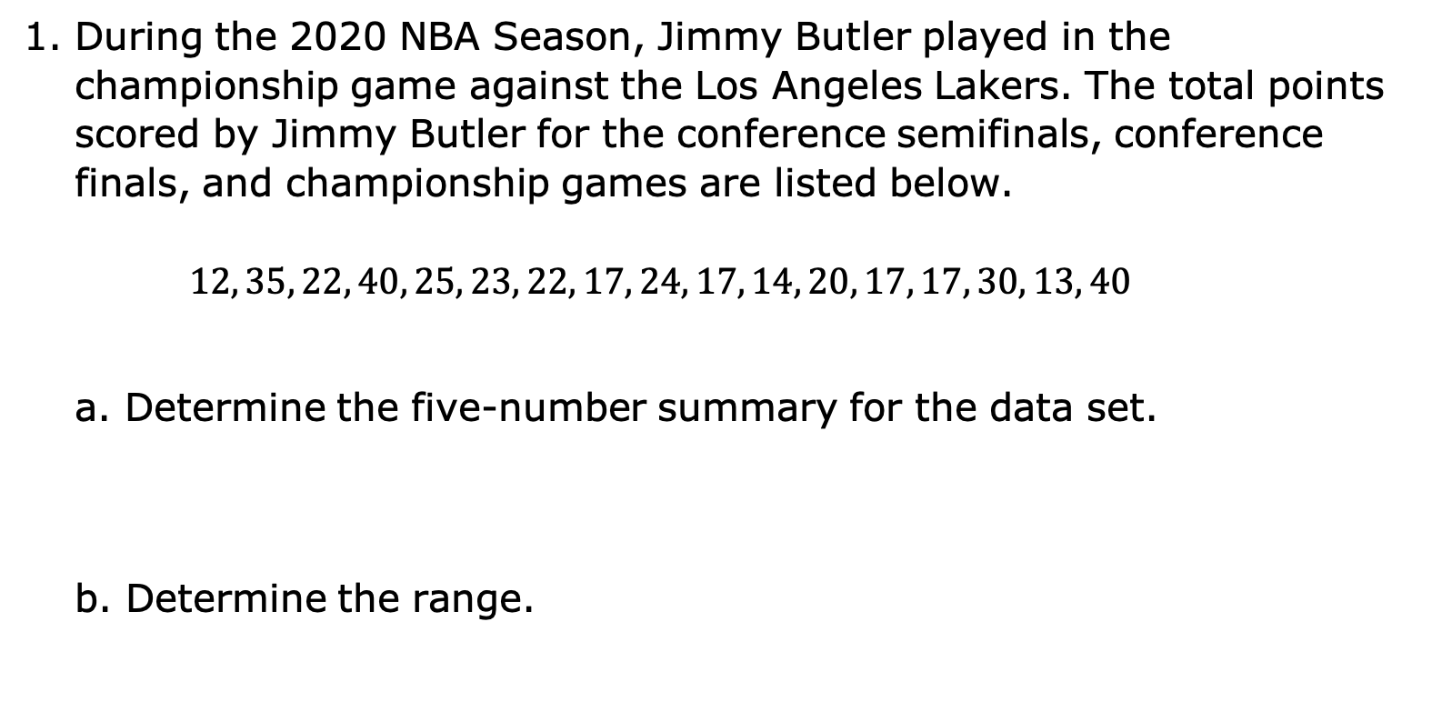
10.1.1 Warm-Up: Bell Work
During the 2020 NBA Season, Jimmy Butler played in the championship game against the Los Angeles Lakers. The total points scored by Jimmy Butler for the conference semifinals, conference finals, and championship games are listed below.
$$12, 35, 22, 40, 25, 23, 22, 17, 24, 17, 14, 20, 17, 17, 30, 13, 40$$
Determine the five-number summary for the data set.
b. Determine the range.
volume 2, pg. 105

Slide 7

Exploration
volume 2, pg. 106

Slide 8

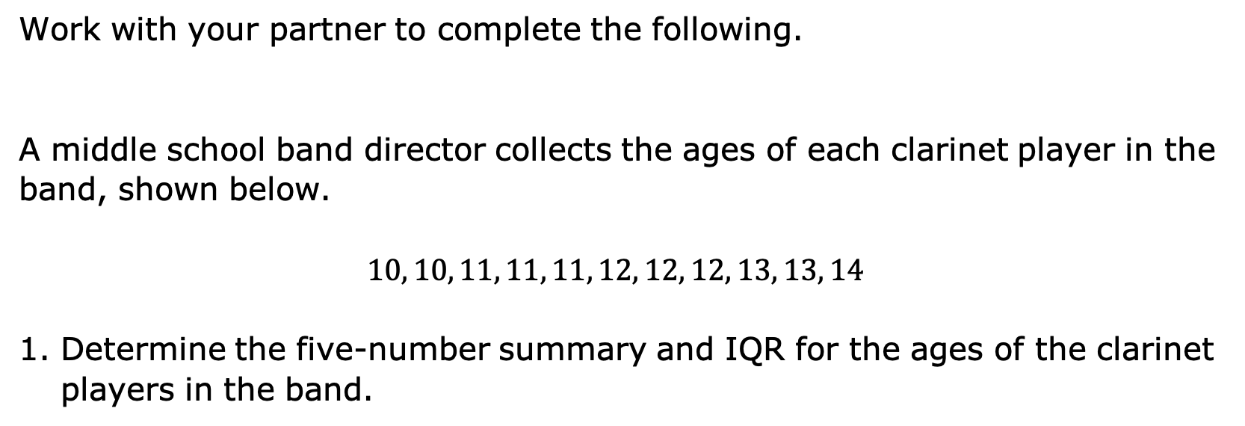
10.1.2 Exploration: Matching Displays
Work with your partner to complete the following.
A middle school band director collects the ages of each clarinet player in the band, shown below.
$$10, 10, 11, 11, 11, 12, 12, 12, 13, 13, 14$$
Determine the five-number summary and IQR for the ages of the clarinet players in the band.
volume 2, pg. 106

Slide 9
2. Which box plot accurately displays the ages of the clarinet players?
Box plot A | Box plot B
Ages | Ages
3. Discuss your choice with your partner and summarize.
volume 2, pg. 106

Slide 10
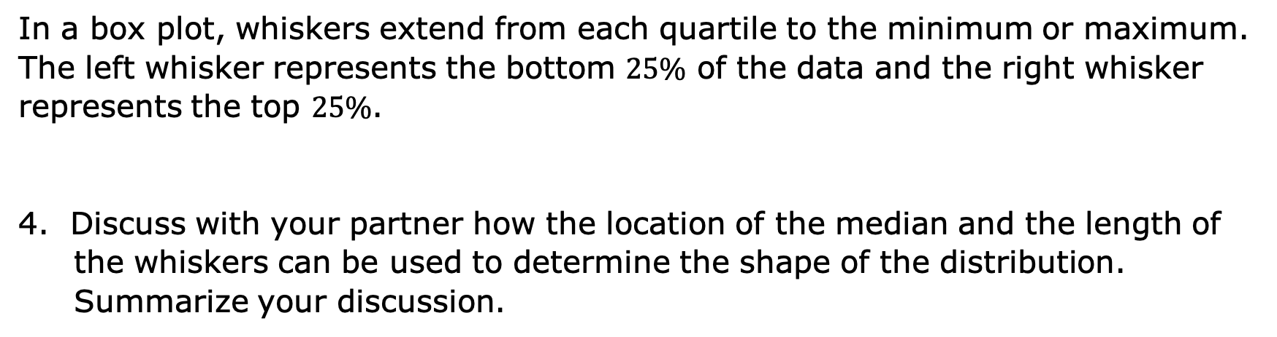
In a box plot, whiskers extend from each quartile to the minimum or maximum. The left whisker represents the bottom $25\%$ of the data and the right whisker represents the top $25\%$.
4. Discuss with your partner how the location of the median and the length of the whiskers can be used to determine the shape of the distribution. Summarize your discussion.
volume 2, pg. 106

Slide 11
5. Create a frequency table of the data set.
Age Range | Number of Clarinet Players
volume 2, pg. 106

Slide 12
6. Which histogram most accurately displays the data?
Histogram A | Histogram B
Age of Clarinet Players Age (in years) | Age of Clarinet Players Age (in years)
Frequency
Frequency
volume 2, pg. 107

Slide 13
7. Discuss which characteristics of the histogram you used to make your selection.
8. Describe the shape of the histogram you chose, including any gaps, outliers, or clusters.
9. Compare the box plot selected for the data with the histogram selected. Discuss which display better represents the data. Summarize your discussion.
volume 2, pg. 107

Slide 14

Activity
volume 2, pg. 107

Slide 15

10.1.3 Activity: Card Sort
An arborist visited a pine tree farm and took measurements of the tree heights, in feet, in three different fields. He dropped his paperwork and all of the data he collected got mixed up.
Complete the table to match each histogram with its corresponding data set and box plot. Write the number and letter from the card that corresponds to each match.
volume 2, pg. 107

Slide 16
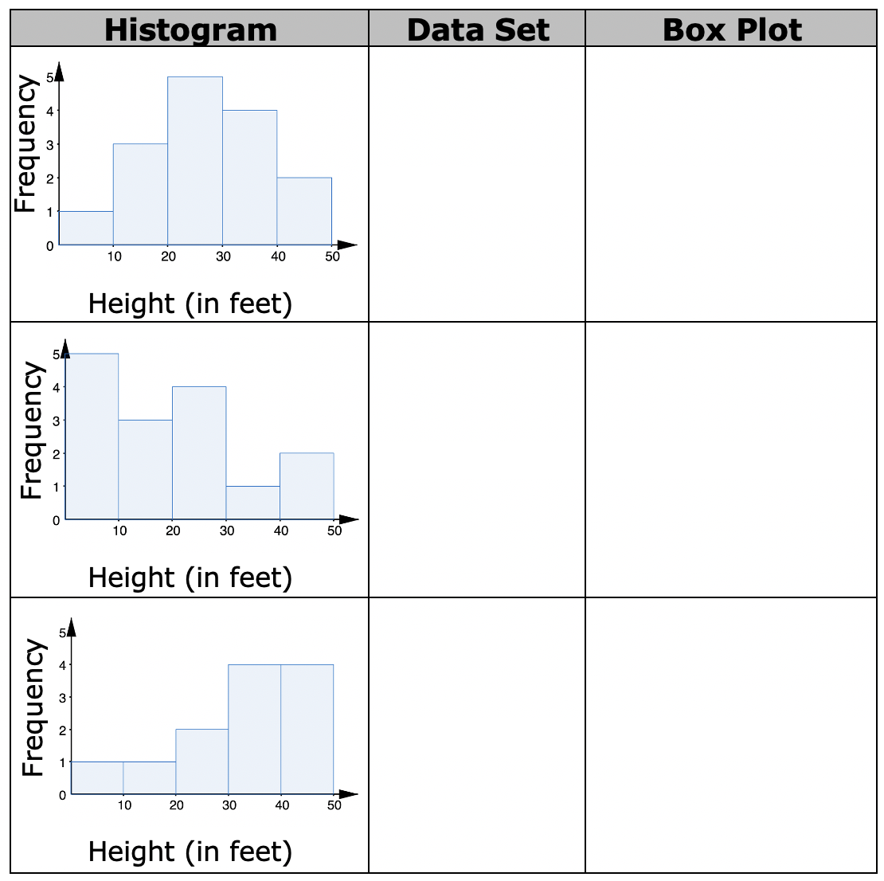
2. Compare your answers with your partner. Make any revisions, if needed.
volume 2, pg. 107

Slide 17

Your Turn
volume 2, pg. 108

Slide 18
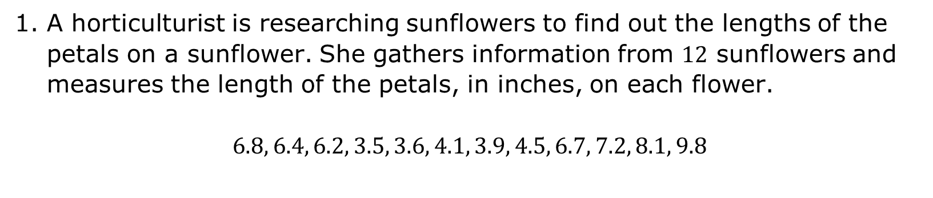
10.1.4 Your Turn!
A horticulturist is researching sunflowers to find out the lengths of the petals on a sunflower. She gathers information from $12$ sunflowers and measures the length of the petals, in inches, on each flower.
$$6.8, 6.4, 6.2, 3.5, 3.6, 4.1, 3.9, 4.5, 6.7, 7.2, 8.1, 9.8$$
volume 2, pg. 108

Slide 19
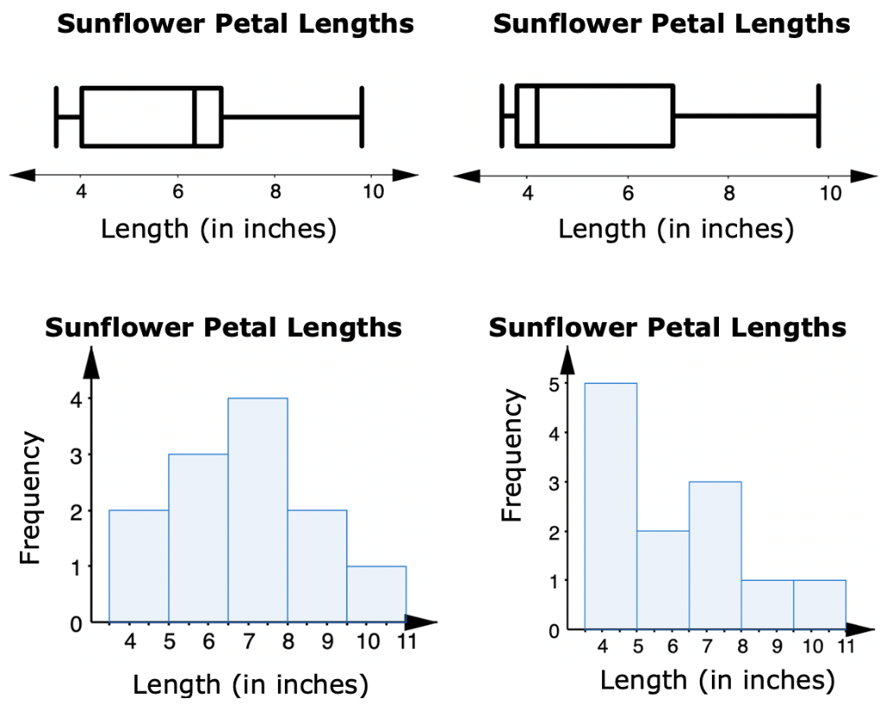
Circle the boxplot and the histogram that best display the data set.
volume 2, pg. 108

Slide 20

Wrap-Up
volume 2, pg. 108

Slide 21
10.1.5 Wrap-Up: Growth Mindset
1. Complete the table as you reflect on today’s lesson.
Which mindset did I demonstrate? | Choose the best description.
Did I use the partner discussions as learning opportunities? | Never Sometimes Usually Always
Did I work on problems that challenged me? | Never Sometimes Usually Always
Did I use strategies to “un-stick” myself when I found the problems difficult? | Never Sometimes Usually Always
volume 2, pg. 108

